Slide 1
15th National Employment Conference
Lohit Bhatia , 18th July 2023

Slide 2
ISF Growth Trajectory
Flexi Staffing industry added new
employment at 14% YoY (2022-23)
ISF Members represent 1.44 mn
Formal Flexi Workforce (2022-23
1.77 lakhs New formal employment added to
the workforce (2022-23)
Sectors like Ecommerce, Logistics, Manufacturing, Tourism & Hospitality, FMCG and CD, Healthcare contributed with new
employment generation (2022-23)
Women Participation in Flexi workforce
continues at 24% (2022-23
YoY Growth – 14% YoY Staffing Industry New employment growth- 2023
2023: Cautious market slowed new employment in H2 22-23, however staffing continued to add double-digit annual growth
2022: Robust employment market generating growth higher than pre-pandemic years
2021: Due to Covid slowing employment
2020: Market volatility impacted employment, slowing staffing growth trend
2019: Strong consistent double digit growth YoY for industry
Source : ISF Flexi Staffing Report 2023

Slide 3
QoQ ISF Growth
Overall flexi staffing industry QoQ added new employment growth at 0.4% in Q422-23
Staffing Industry break up, General Staffing industry contributed with new employment at a +0.8% growth in Q422-23, whereas IT Staffing dropped -6% in the last Qtr , Q4 22-23
IT Staffing witnessed a gradual slowdown in new employment creation since Q3 22- 23, that impacted very heavily on the overall staffing industry net employment growth for 22-23.
Among many factors including the ongoing geo political tensions, impact of Russia-Ukraine war, turmoil in US financial markets the IT industry started rightsizing since H2. Most other sectors, also came in with a caution on new employment generation in 22-23,
Source : ISF Flexi Staffing Report 2023

Slide 4
General Staffing Vs IT Staffing
Source : ISF Flexi Staffing Report 2023

Slide 5
Flexi Staffing Industry FY 23
Industry Annual Salary Payable
Rs 113,760 Cr
Flexi Staffing Industry Annual Contribution
to Social Security and GST (appx)
Rs40,759 Cr
Industry
Industry Size
Rs 130,949 Cr
$15.97 Bn
Source : ISF Flexi Staffing Report Q3 2023

Slide 6
Flexi Staffing Penetration in Workforce
Flexi Staffing Market $16 Bn
Source : WEC Economic Report 2023, ISF Flexi Staffing Report Q3 2022-23

Slide 7
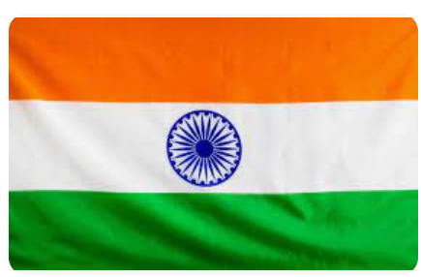
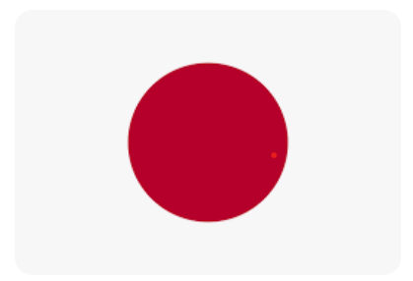
Staffing Market to GDP
Staffing $187 Bn
(0.91 %GDP share)
Staffing $158 Bn
(1.29 %GDP share)
Staffing $80 Bn
(1 %GDP share)
Staffing $60 Bn
(1 %GDP share)
Staffing $73 Bn
(1.5 %GDP share)
Staffing $40 Bn (1.08 %GDP share)
Staffing $16 Bn (0.43 %GDP share)
Staffing $32 Bn (2.4% GDP share)
Source : WEC Economic Report 2023

Slide 8
ISF HC Growth vs GDP Growth
ISF HC
+3.7%
+8 %
1.05 Mn
GDP Growth
+0.8%
+5 %
1.05 Mn
+1.9%
+7.5%
+2.6%
1.05 Mn
+7.1%
1.05 Mn
1.05 Mn
+ 4.3%
1.05 Mn
1.05 Mn
1 Mn
1.05 Mn
-7%
+1.1%
0.98Mn
0.94 Mn
0.93 Mn
Source : https://statisticstimes.com/economy/country/india-quarterly-gdp-growth.php

Slide 9
288 Mn Work force ( eShram portal)
Incremental GDP Rs 32,520,000 Cr
Wage Exp as % of Incr GDP = 30%
Share of bottom pyramid Empl = 30% of the above
Share of bottom pyramid Empl=2,926,800 Cr
Incremental formal Jobs = 77 Mn ( 3.8 L PA)
Formal Staffing
Incremental Value
22-25K PM Earnings
$8,100 Bn
Targeted GDP
Informal Work
Targeted GDP = $ 8,100 Bn
Services + Manfg Share = 75%
Services + Manfg Share = $6,075 Bn
Incremental GDP = $ 4,065 bn
Incremental GDP Rs 32,520,000 Cr
5K -8PM Earnings
MNREGA
3K PM Earnings
Current GDP = $ 3,750 Bn
Services Share = 53.6%
Services GDP Current $ 2,010Bn
$3750 Bn
Current GDP
Source : esharm portal June 2023,

Slide 10
Thank You!

